Slide 1


Movie Recommender System Using MovieLens Data
Elizabeth Sabiniano

Slide 2
Introduction
Personalization and recommendations help increase business value and sales of products.
Recommender systems are a subclass of information retrieval systems.
Goal is to predict a ‘rating’ a user gives to a product or a ‘recommendation’ to a user based on past preferences.
Example Companies: Netflix, Amazon, Spotify, Zillow, Uber Eats, LinkedIn
Main Approaches: Content-based Filtering and Collaborative Filtering

Slide 3

Project Overview
Data & Analysis
Exploratory Data Analysis
Recommender Systems
Advantages & Disadvantages
Results
Conclusion & Future Work
References

Slide 4
Data and Analysis
Movielens dataset
Analysis & pre-processing
MovieLens Website:
Uses collaborative filtering to provide recommendations
Utilizes ratings and reviews
GroupLens Research Lab:
Social Computing Research at University of Minnesota
Gather and publish ratings data
Data:
4 CSV files: movies, ratings, tags, links
9742 unique movies
610 unique users
100,000 ratings (ranging from 0.0 to 5.0)
Datasets ‘movies.csv’ and ‘ratings.csv’ are merged to create a main dataframe.
‘timestamp’ feature is dropped
Minimum rating given: 0.5
Maximum rating given: 5.0
Average rating: 3.5
Number of Genres: 18

Slide 5
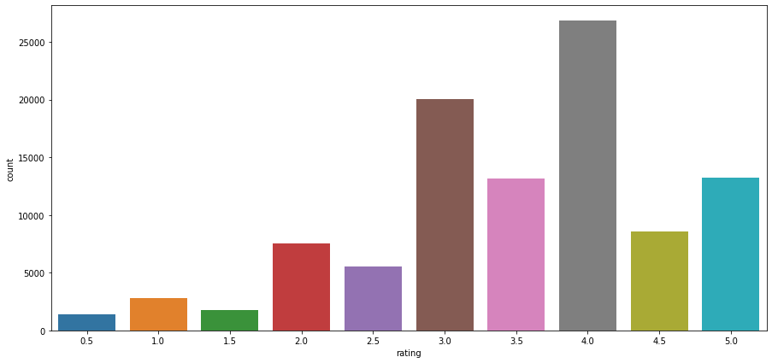
Rating Count Distribution
Exploratory Data Analysis

Slide 6
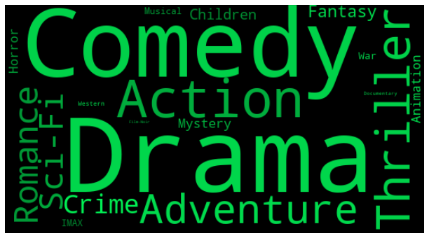
WordCloud of Movie Genres

Slide 7
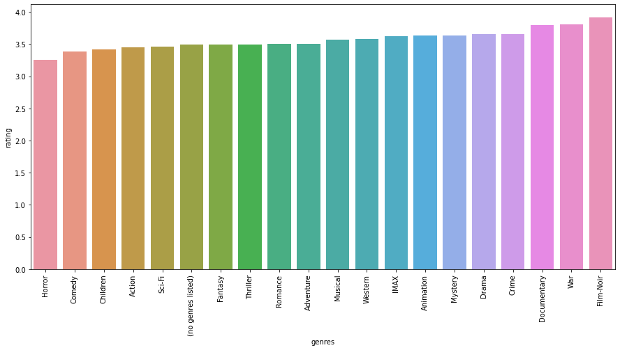
Average Rating per Genre

Slide 8
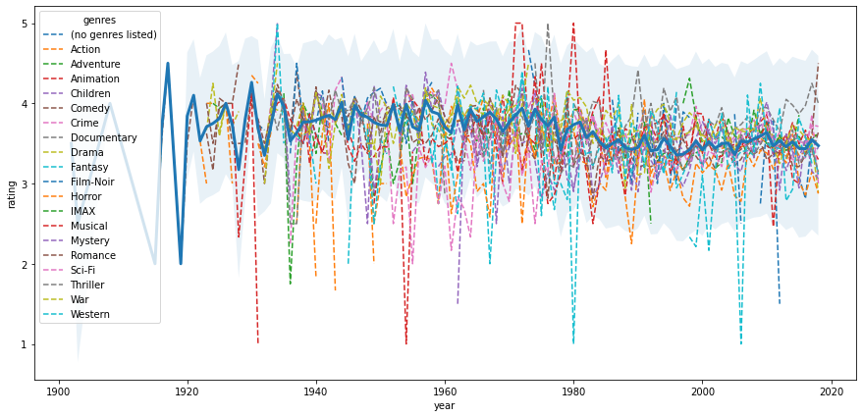
Average Ratings Over Time

Slide 9
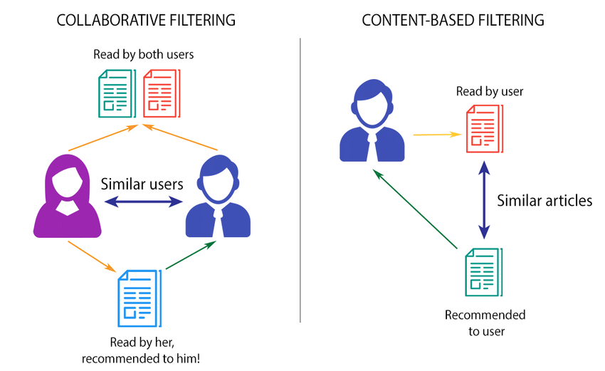
Recommender Systems

Slide 10
Content-Based Filtering Approach
Movie genres are used as attributes to form as similarity matrix for each users
Determine the sorted movie recommendation using similarity scores

Slide 11
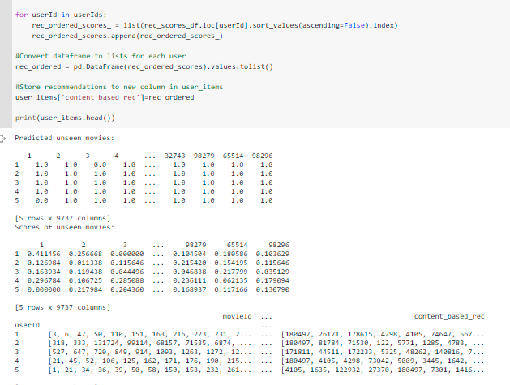
Example:
userId = 1 Recommendation
movieId | Title
180497 | The Post (2017)
26171 | Play Time (a.k.a. Playtime) (1967)
178615 | Front Cover (2016)
4298 | Rififi (Du rififi chez les hommes) (1955)
4105 | Evil Dead, The (1981)
74647 | Motherhood (2009)
5670 | Comedian (2002)
128852 | Chris Rock: Bigger & Blacker (1999)
505 | North (1994)
57502 | Cat Soup (Nekojiru-so) (2001)

Slide 12
Model-Based Collaborative Filtering: Approach
Surprise Library – Read and Load ratings data
Perform SVD(), KNNBasic(), KNNWithMeans()
Pick best model through MAPK
Input: User ID
Exclude movies previously rated by target user
Using best model, predict the ratings for the remaining movies
Set actual and estimated rating threshold of 3.5 or above
Sort and Recommend movies similar for a particular user

Slide 13
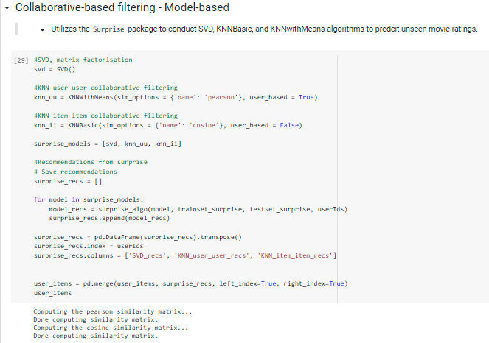
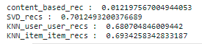
Example:
userId = 1 Recommendation
movieId | Title
2329 | American History X (1998)
1197 | Princess Bride, The (1987)
1270 | Back to the Future (1985)
3671 | Blazing Saddles (1974)
457 | Fugitive, The (1993)
1 | Toy Story (1995)
1090 | Platoon (1986)
2542 | Lock, Stock & Two Smoking Barrels (1998)
1073 | Willy Wonka & the Chocolate Factory (1971)
296 | Pulp Fiction (1994)

Slide 14
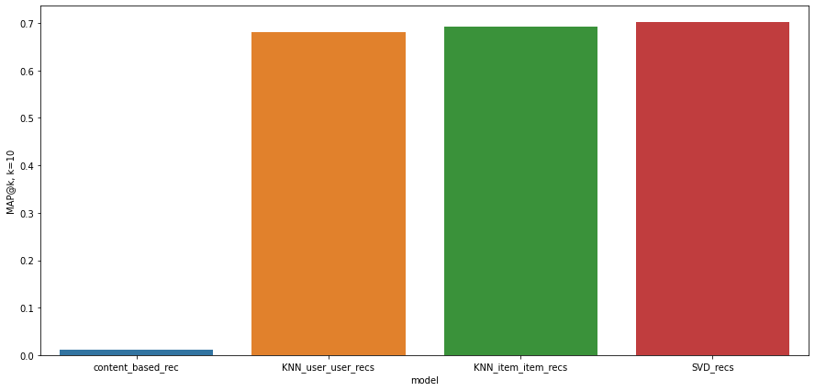
Results
0.681
0.693
0.701
0.012
Notes:
content_based_rec : 0.012197567004944053 SVD_recs : 0.7012493200376689 KNN_user_user_recs : 0.680704846009442 KNN_item_item_recs : 0.6934258342833187

Slide 15
Advantages & Disadvantages
Content-based filtering
Collaborative filtering
Can scale large number of users (since it does not need external user information to generate recommendations)
Captures specific interests of users
Models cannot expand the existing interests of a user (since it makes recommendations based on existing user)
No domain knowledge is required (embeddings are automatically learned)
Helps users expand their interests
Faces the cold-start problem (new items will not be included in the training, hence embeddings for them will not be created)

Slide 16
Summary
Conclusion/recommendations
Future work
Goal: High-level understanding of the various methods.
Model-based approach was faster and provided efficient results.
Implementation of Deep Learning models – RNNs, LSTMs.
Extensive Hyperparameter Tuning increases performance, scalability and efficiency.
Incorporating use of implicit ratings and metadata of movies, ratings and users.

